Slide 1


Improving outcomes for young offenders, whānau and communities
December 2022

Slide 2

Seminar Overview
Context: Phil Spier from the Evidence Centre will present a brief overview of some current trends in youth justice
Keynote: Professor Ian Lambie ONZ draws on his recent research to reflect on children who offend and the current state of the care and protection system and where improvements could be made
Oranga Tamariki Ben Hannifin, Director of Youth Justice System
Perspective: Development at Oranga Tamariki shares his experiences and discusses where improvements could be, and are being, made

Slide 3
Questions?
If you have any questions or comments, please use the ‘chat’ function to lodge these.
We will monitor the questions and present as many of these as possible to the speakers where time allows
Youth Justice
A look at the figures and recent research

Slide 4
Damian O
Context: A brief overview of some current trends in youth justice

Slide 5
Police proceedings (10–17 year-olds)
Overall, youth crime has decreased
Source: https://www.police.govt.nz/about-us/statistics-and-publications/data-and-statistics/proceedings-police-stations
Notes:
Over the past 8 years (between 2014/15 and 2021/22) the number of police proceedings involving children and young people has halved.
Over the past 2 years, the total number of proceeding has plateaued with 2-3% reductions each year (compared to 14% reduction between 2019 and 2020 – ie pre-pandemic)
The large blips in June 2016 and June 2018 are not spikes in youth crime – but some missing data being back-loaded by police towards the end of the two financial years.

Slide 6
Breakdown by Ethnicity
Overall, youth crime has decreased for each ethnic group
Source: : https://www.police.govt.nz/about-us/statistics-and-publications/data-and-statistics/proceedings-police-stations
Notes:
Proceedings have not been reducing at the same rates across ethnicities.
Between 2014/15 and 2021/22 there was a 68% reduction for European/other (and similar for Pacific young people) compared to 48% for Māori
Over the past 2 years, there was been effectively no change in the number of proceedings involving Māori tamariki and rangatahi while European/other proceedings continue to decline (16-18% each year)
This data is limited by the increase in “unknown” ethnicity.
In case anyone asks about the increase in “unknown” ethnicity. This is not a mandatory field for Police and front line officers may be increasingly reluctant to assume people's ethnicity.

Slide 7
Breakdown by Ethnicity
Māori remain considerably over-represented in the youth justice system
* Due to a growth in the Unknown ethnicity category, percentages are based on known ethnicities.
Source: https://www.police.govt.nz/about-us/statistics-and-publications/data-and-statistics/proceedings-police-stations

Slide 8
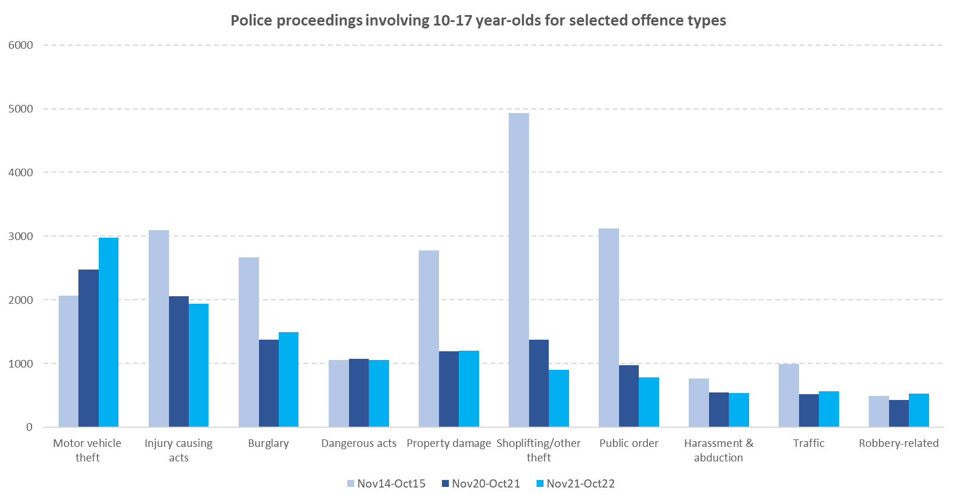
Breakdown by Offence Type
Source: https://www.police.govt.nz/about-us/statistics-and-publications/data-and-statistics/proceedings-police-stations

Slide 9
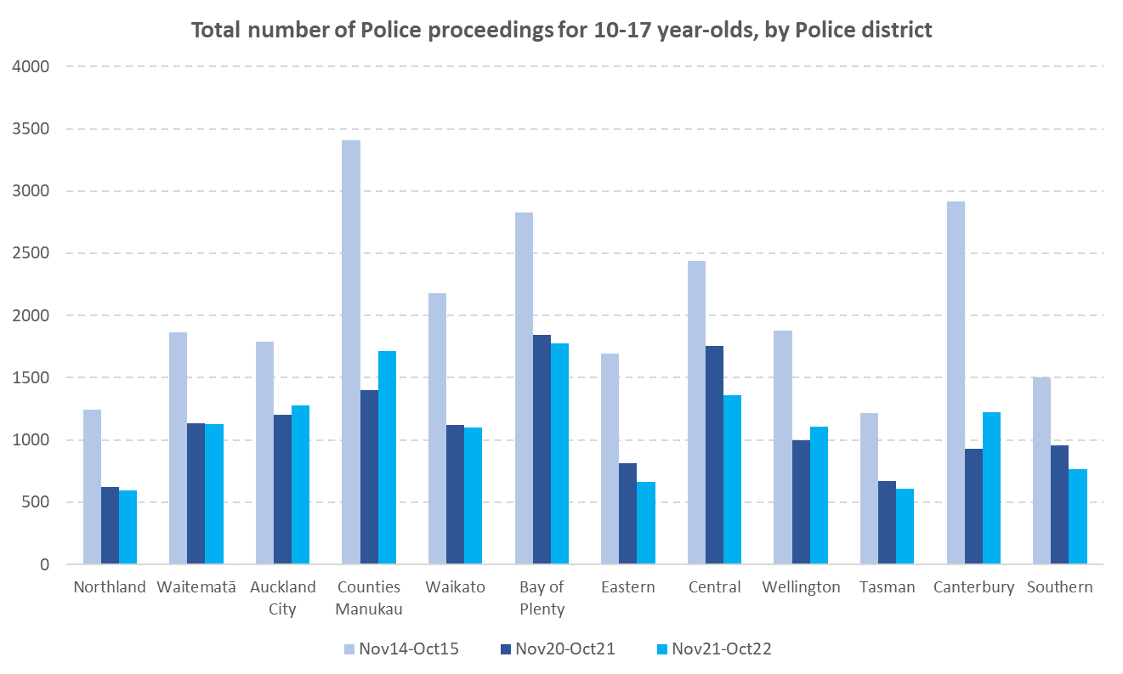
Breakdown by Region
Source: https://www.police.govt.nz/about-us/statistics-and-publications/data-and-statistics/proceedings-police-stations

Slide 10
Summary of youth offending trends
Youth crime (10–17 year-olds) has halved over the longer-term.
This large decrease occurred across all ethnic groups, although not evenly, and Māori remain considerably over-represented in youth justice.
There has been a rise in youth crime over the last six months, but numbers are still well down on those in earlier years.
Much of the recent rise in youth crime involves an increase in motor vehicle theft.
The recent rise in youth crime has only been seen in a small number of police districts (highest in Counties Manukau and Canterbury).
Where to for youth crime?
  “As COVID-19 containment measures ease …conditions are likely to be conducive to a resurgence in youth offending, as unemployment increases, financial supplements decrease, and interruptions to schooling impact on educational engagement” - Queensland researchers, March 2021
  Initial impacts of COVID-19 on youth offending: An exploration of differences across communities (sagepub.com)
Notes:
Journal of Criminology, Volume 54, Issue 3, Sep 2021, Pages 265-404
Initial impacts of COVID-19 on youth offending: An exploration of differences across communities
Molly McCarthy, Jacqueline Homel, James Ogilvie and Troy Allard
Griffith Criminology Institute, Griffith University, Brisbane, Australia

Slide 11
Damian O’Nei
Keynote: Professor Ian Lambie ONZ
Reflections from “How we fail children who offend and what to do about it: A breakdown across the whole system”

Slide 12
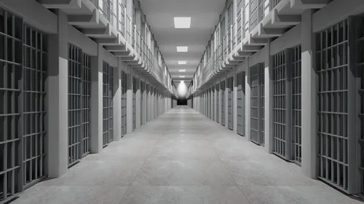
The opportunity of a life time

Slide 13


First, thank you
To all the stakeholders we interviewed – whānau and frontline
And to our Research Advisory Group members:
  Arohanui and Huia Hawke
  Emily Lodge
  John Horwood
  Leland Ruwhiu
  Zane Yeoman
  and others
Lisa Sepuloni
Debbie Haretuku
Peter Hepburn
Staff at Otara and Onehunga
Beth Ferguson
James McIlraith
Vince Galvin
Jessica
Olivia

Slide 14



How we fail children who offend and what to do about it:
A breakdown across the whole system
Ian Lambie, Jerome Reil, Andrew Becroft, Ruth Allen
i.lambie@auckland.ac.nz

Slide 15

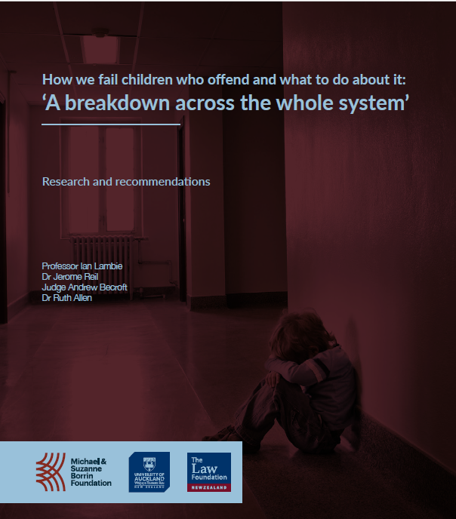
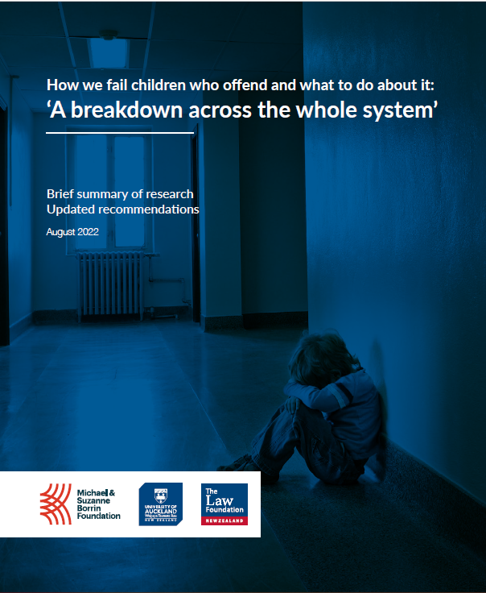
Notes:
Maori are overrepresented because of the terrible legacy of colonisation – injustice for Maori has continued down the generations to the present day.

Slide 16
All I see is this little boy
The first thing that comes to mind are the faces. I'm not very good at names but I remember the faces. I just went yesterday to a sentencing, an 18-year-old, I didn't go in my capacity as lawyer for child, I just went to support him because he was my client when he was 13.
I visited him in [prison remand], this 18-year-old, and I sat opposite him and all I could see was the 13-year-old when I first started acting for him. He's up for sentencing for aggravated robbery.
He was sitting with three other co-defendants, all the same age, all similar histories. My guy that I first acted for was uplifted from care of mother and stepfather due to physical abuse by both parents at 13.
I acted for him and the youngest sibling, who at the time was 3 and he was already displaying behavioural issues at school.
I'm looking at him and all I see is this little boy and he's saying, ‘Talia*, the longer I'm in here, I'm really scared that I'm going to get really hardened and it’s worrying because all around me are these bad people and I feel like they're taking me down with them.’
He's scared and to me … when I saw that, I just thought, the first thing I see is these children’s faces, they are real kids and this, and each file I have are separate children with histories

Slide 17


Solvable problem
In 2020 there were 170 children are under Section 14(1) (e) – that’s still under 14 years old

Slide 18
Study Aims:
Scientific and up-to-date information on the characteristics and backgrounds of children who have offended, the trajectory they often follow, and opportunities for improvement in child welfare and Family Court practices to assist children and their families more effectively
IDI data on 48,989 children, from 2000 to 2019
Oranga Tamariki Case Files – 2019-2020 – 108 children 14(1)(e)
Interviews – 33 key stakeholders (justice-involved whānau, iwi representatives, lawyers, police, social workers, school leaders, psychologists, lay advocates)

Slide 19
Offending does not stop
Notes:
Of the children who did not offend as a child, 10% offended as a youth.

Slide 20
Frequency of offending
Most offended only once as a child; however, then went on to offend significantly more often as a youth
Those who had offended as a child and as a youth offended significantly more times than did those who only offended as a youth

Slide 21
Child offending does not occur in a vacuum
Child Welfare Issues
ROC
Out-of-home placements
Family Group Conferences
Self-harm
Justice-involved parents
Education Issues
Suspensions
Expulsions
Multiple school enrolments
Socioeconomic Issues
School decile
Receiving a benefit

Slide 22
Child offending does not occur in a vacuum:
Child Welfare Issues
Notes:
A child abused under the age of 5 was six times more likely to offend as a child and youth, than was a child who had not been abused

Slide 23
Reports of concern/ notifications to Oranga Tamariki
In their early lives, there were 1000s of reports of concern about children who went on to offend:
- 1151 ROCs before age 5
- 2888 ages 5 to 10
- 3223 from age 10 to 14
Child Welfare
Issues

Slide 24
Out-of-home placements and state care
Out-of-home placement before 5th birthday were more likely to offend (across all age groups) compared to those who did not
Those who had offended as a child and had a placement before age 5 were significantly more likely to also offend as a youth (82%)

Slide 25
Family Group Conferences
Most children who were offending had had at least one FGC.
A few had had as many as 4 FGCs before age 14
The average length of time it took from referral of an under-5-year-old to the FGC being held was 5 months
(159.5 days)

Slide 26
Family Group Conference before 5 years old
Children who had an FGC before the age of 5 and offended as a child were more likely to reoffend aged 14-18, compared to those who did not
Notes:
(147 children)

Slide 27
Justice-involved parents
Offending could be intergenerational with risks of offending increased with a justice-involved parent

Slide 28
Education
Issues
Suspensions
Children who were stood down or suspended from school before age 10 were significantly more likely to offend at all age groups
30% of those who had offended as both a child and young person had been suspended
Children who offended, and had been suspended or stood down between age 5 and 10, were also significantly more likely to reoffend

Slide 29
School expulsions
Nearly half (47%) of those expelled from school before age 14 offended as both a child and young person
85% of those who had offended as a child and had been expelled before age 14 offended again from age 14-18
Notes:
The 47% is just 102 children

Slide 30
Multiple school enrolments
For each extra school enrolment by age 10, the odds of offending increased 1.6 times
Of those who had been to 7 or more schools by age 14, almost a quarter (24%) had also offended by that age
Children who offended were less likely to be still enrolled at school at age 16 than were non-offending peers

Slide 31
Poverty and disadvantage
So, if you look at the poverty aspect…to raise these people out of the poverty blights that they’re in. There’s the historical nature that goes back to colonisation cause obviously Māori particularly are overly represented. (Police officer)
Offending risk decreased as school decile increased - 9-year-olds at a Decile 1 school were 2.1 times more likely to offend than their peers at a Decile 10 school

Slide 32
Poverty and disadvantage
Financial hardship was a risk factor for offending (having a parent eligible for income support payments), as was having a parent who was involved in the justice system
I guess I think about racism, and I think about generational racism and the fact that resources have not been provided for those families. (Lawyer, Julie)
Notes:
9% of children who offended both as a child and young person had two justice-involved parents, in contrast to 1.6% of child and youth offenders who did not.
Not that poverty causes crime, but if you think about your own babies/infants/children – what if you lost your job, couldn’t provide them with a warm, dry home, the healthcare they needed, extras like sport, holidays, couldn’t spend time with them because you were trying to work 3 jobs, had an ex-partner who was emotionally abusive/dangerous, having to move, re-settle at new schools, homes etc etc etc …. We can see how it compounds.

Slide 33
Three key issues identified
1. Intervention is far too late
2. Poor engagement
3. Difficulty accessing support

Slide 34
Intervention is far too late
It’s too late by the time I see them.
I’ve seen it in kids as young as 3, in preschool, the ones that step on the kittens’ heads, who whack other children …
I’m thinking wow, okay, that’s one that I can identify straight away - unless there are some supports, even at early childhood, that ECE [early childhood education] level, then I will see that child again. (Lawyer, Talia)

Slide 35
Intervention is far too late
We always talk about prevention but I’m not sure we actually do it that well.
I think there are opportunities.
If we’re talking about risks of offending, we’re talking about siblings of known offenders, we’re talking about behaviours that are evident in small children at early childhood, at kindy, at early primary school years.
(Police officer, Nikau)

Slide 36
Poor engagement
The ones that work well are where you have got a social worker who’s got on side with the family and have got the trust of the family and the family realises Oranga Tamariki’s not out to get them, Oranga Tamariki wants to help them
(Lawyer, Jasmine)

Slide 37
Poor engagement
We see Youth Aid staff coming in and out, social workers changing, all that does is really reinforce for this child that everyone, anytime anything good happens, people leave.
Consistency is really important.
(Police officer, Nikau)
Notes:
Intensive engagement and relationship building are fundamental to supporting children and whānau and bringing about positive change. What do we need to do to support that?

Slide 38
Difficulty accessing support
So, I’ve got an FGC today. Police referred him under 14(1)(e) because OT weren’t taking any action.
Police referred him in September last year for an FGC, we’re getting it today [11 months later].
So, what’s the problem there? Delay. It’s the same with the Family Court, delay, delay, delay, not in the child’s sense of time, not the action needed when it needs to be. (Lawyer, Jasmine)

Slide 39
Difficulty accessing support
If a doctor had listened to me back when she was smaller, I reckon, if she had gotten the help when she was 2, I believe it would have been different (Whānau member)

Slide 40
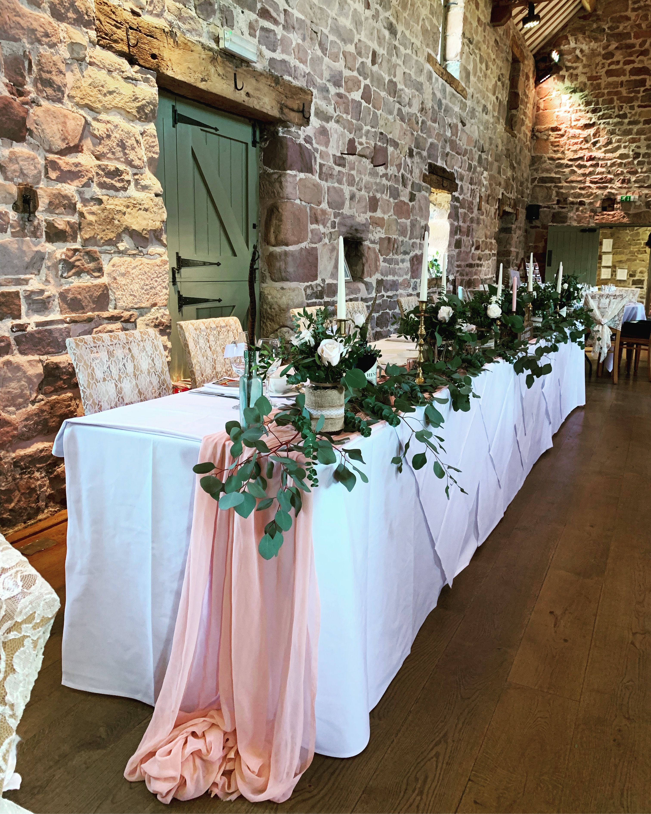


Disconnect between what the Evidence says,
Policy and Practice

Slide 41
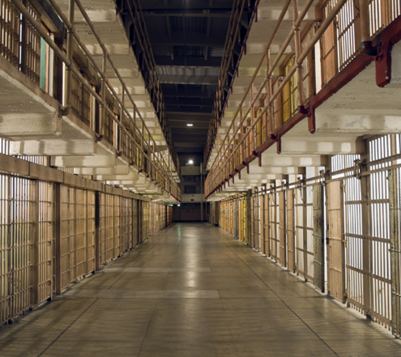

Despite youth justice reforms since the late 1980s in New Zealand, law and practice about children who offend between 10 to 13 years has been often overlooked.
This limits the child welfare system’s and Family Court’s ability to use evidence-based resources to improve outcomes, and hampers systemic improvement.

Slide 43
Lack of joining the dots
If they had looked into the police callouts, where I tried to stop the father turning up at my house uninvited and disrupting our household, and the way that I was trying to struggle, managed and raised the kids, that they could have been a bit more helpful in the situation instead of labelling me as bad mother, that I couldn’t provide for my children (Whānau)

Slide 44
Systemic challenges
It’s amazing how a great social worker will make a lot of things happen where another social worker might not make things happen. So, the personal responsibility is really important but also the resources. (Lawyer, Andrew)
The Family Court has some barriers, [it’s] a very, very busy court.
One of the chief complaints of Family Court Judges is the lack of time to make informed and meaningful decisions. … they are literally given minutes to make their mind up whether a child should be removed or not. (Lawyer, Robert)
Notes:
How can ALL social workers be supported to do great work, not just some individuals? How call ALL judges have time to really consider matters

Slide 45

What can you do?

Slide 46
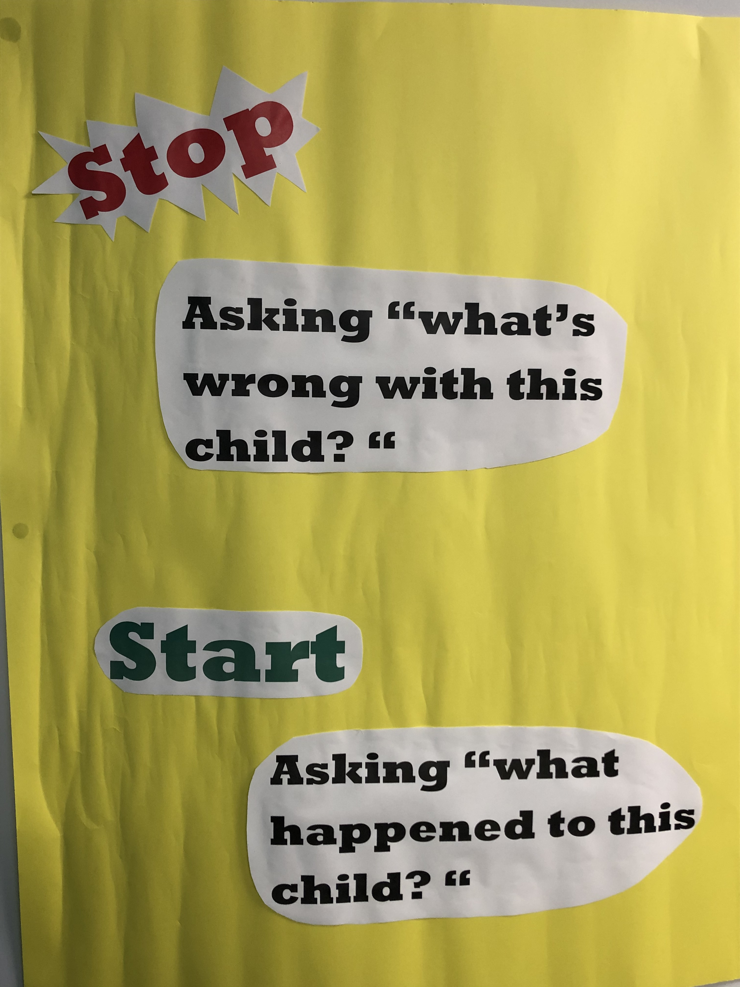
What has happened to you?
How did it affect you?
What sense did you make of it?
What did you have to do to survive?
Notes:
“Trauma-informed” is a buzzword – all it means is that you don’t just look at the (bad) behaviour, you figure out what’s happened to make them behave like that and what they could learn instead, if they were responded to differently…

Slide 47
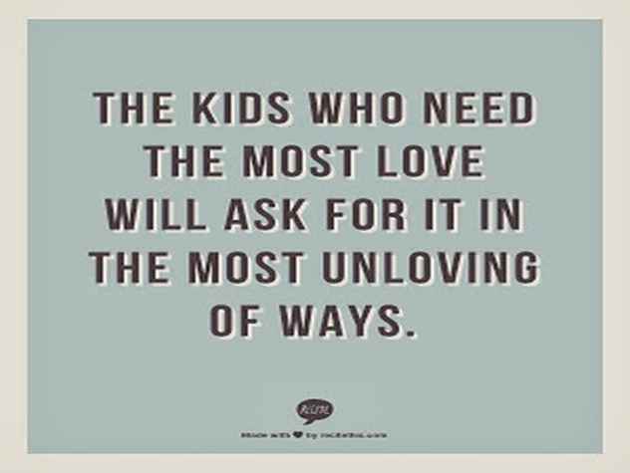
Notes:
Have you or your kids ever behaved “badly” to get your needs met? Have you ever drunk too much, driven too fast, overspent on your credit card, because you were really upset about something?

Slide 48
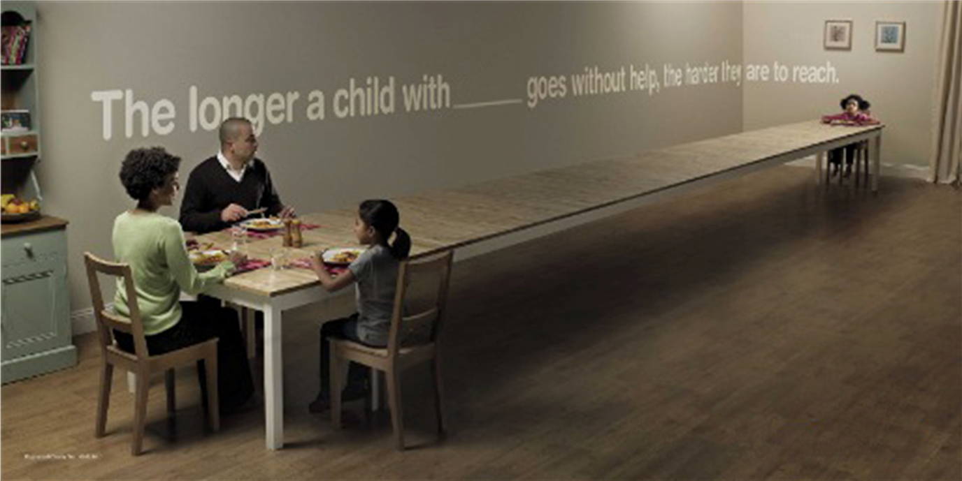

Slide 49
Change that works
To assist in a change programme, there must be adequate investment in piloting and evaluating early intervention and prevention initiatives to ensure evidence-based, cost-effective programmes are implemented
It’s also simple – what do you and your children need to thrive?
How can everyone have that?
Notes:
Start Well, iwi-based programmes, meth treatment programmes, Youth Horizons Trust, [others ….] – lots of good work, not scaled up enough.
Day-to-day, it’s about not judging the disruptive kid at kindy or school and just wanting him kicked out

Slide 50
Change that works
Systems and services, currently measured by individual outputs, must work together to meet the needs, and with sustained leadership, to get staff trained and supported to work well across sectors and diverse communities
But it’s also about reflecting on our beliefs about relationships, and who is responsible for whānau/family wellbeing in our communities, and how public and private resources should be applied

Slide 51
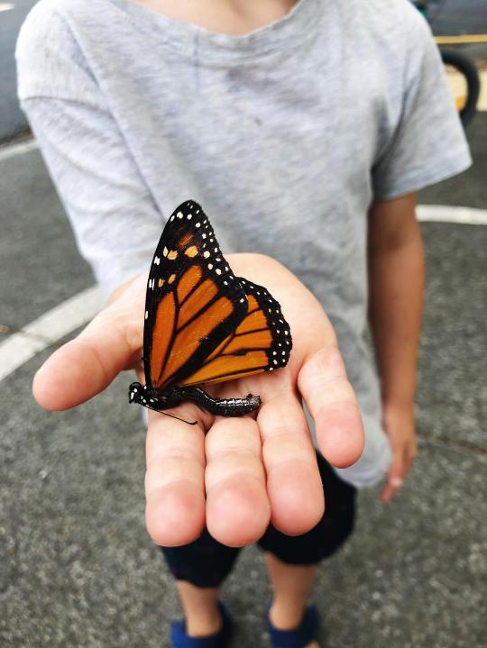
We need to take note of implementation science, start with the needs of children and families at the centre and work out how to meet them, guided by evidence from science, Te Ao Māori and real-world experience
Notes:
Real-worth experience like that of the following young defendant …. (next slide)

Slide 52
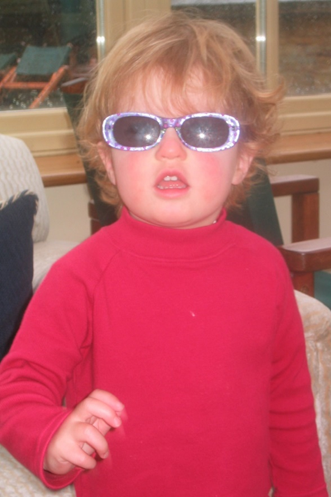
A young defendant with neurodisability reporting his experience of appearing in court……
I couldn’t really hear,
I couldn’t understand,
but I said ‘Yes’,
whatever, to anything, because if I say,
‘I don’t know’,
they look at me as if I’m thick…..

Slide 53
In concluding…..
This report is about young children. Those under the age of 14.
With fewer than 200 children each year, this is a solvable problem. (And if we get better at responding to those children and their families, we can be more confident about helping others who are heading the same way but are not yet there.)
If there was ever a case for early intervention, then this report tells us why. Trouble for almost all these children started while they were infants, or well before they were 5 years old.

Slide 54
This report highlights a problem that’s never been addressed in Aotearoa New Zealand and goes back 30+ years.
The legislation and structure to address it are in place – it just hasn’t been addressed in terms of system leadership.
We need broad, inter-government and community co-operation and collaboration to solve operational and practical problems that could be so easily fixed if there was a will to do so.

Slide 55
My questions to you are?
Who on this webinar had a choice about the family into which you were born?
Who has been shaped by an experience prior to the age of 15 that impacts on you today?
Who has not been impacted by crime?

Slide 56

Talking about the wellbeing of babies seems a long way from arguments with politicians about the prison muster, but that is where the evidence says we must begin……

Slide 57
Oranga Tamariki Perspective: Ben Hannifin, Director of Youth Justice System Development at Oranga Tamariki

Slide 58
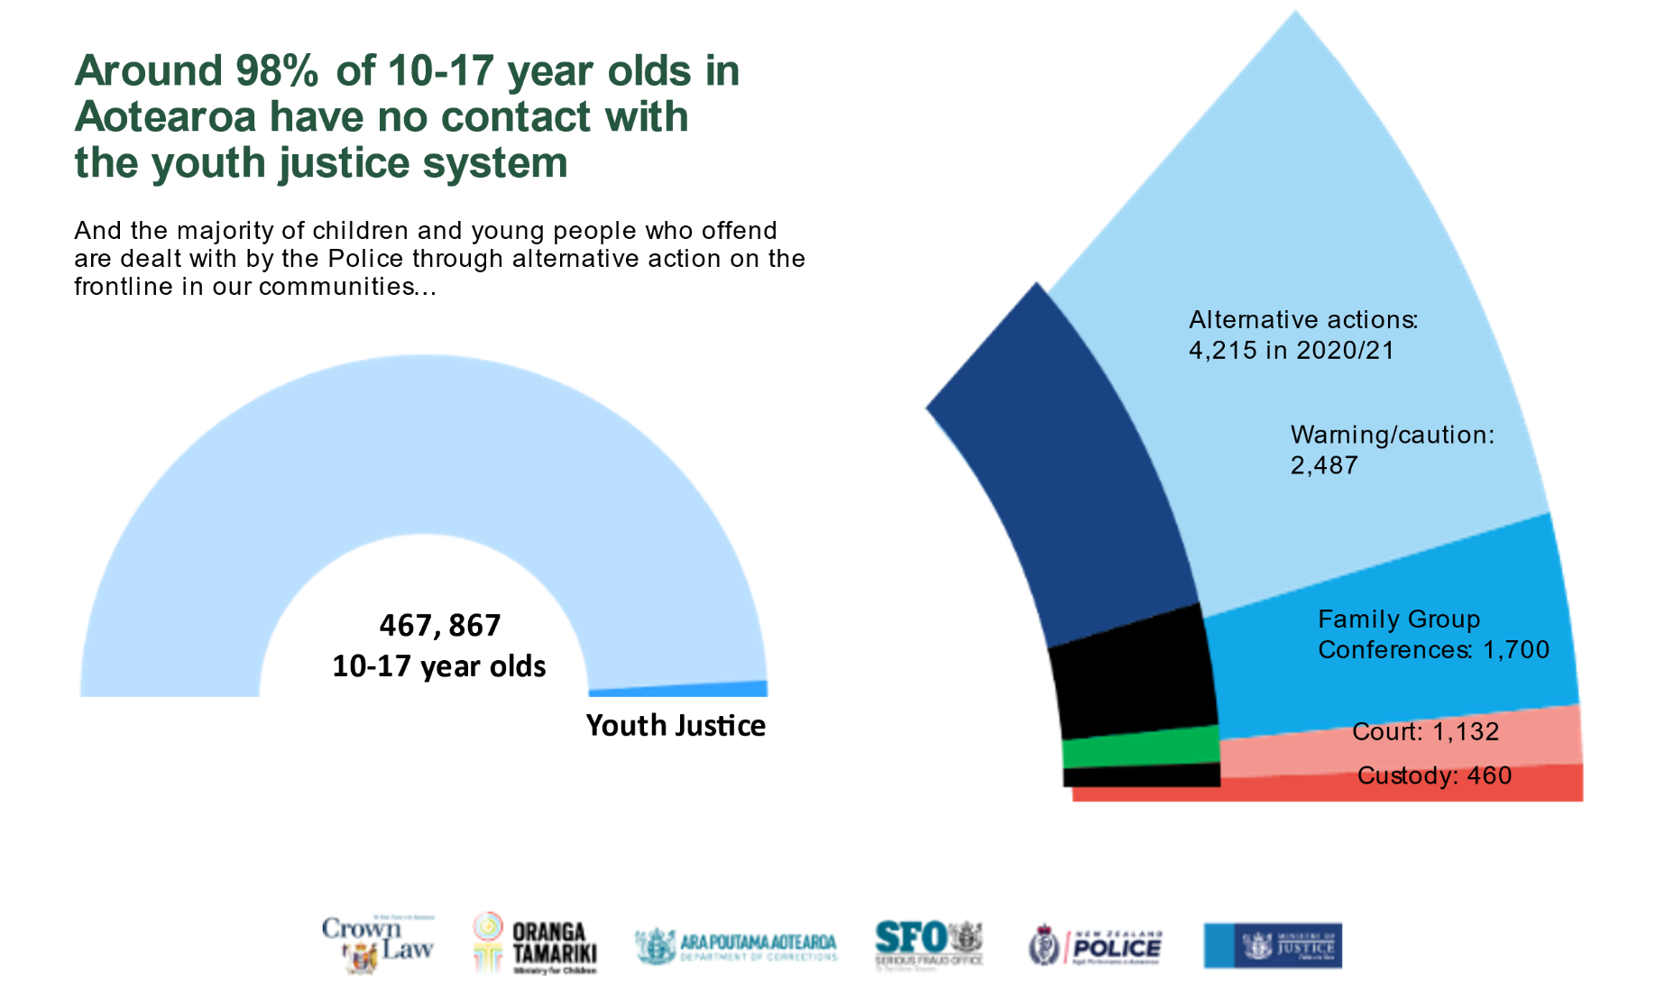
Youth offending in context: Young people who offend are a very small part of our population

Slide 59
Damian
And finally…

Slide 60
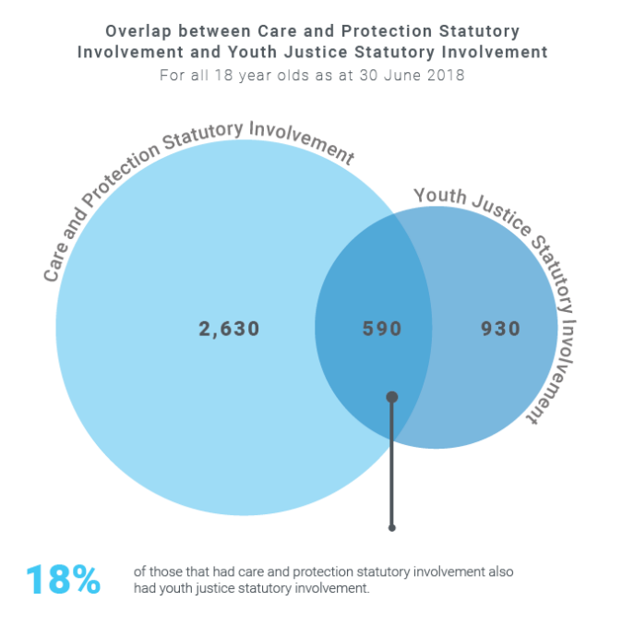
Common Misconceptions
Being involved in care and protection does not mean a child or young person will become involved with the youth justice system.
Source: Youth justice insights - separating misconceptions from facts (orangatamariki.govt.nz)
Notes:
Despite the commonly held belief that being involved in care and protection leads to youth justice involvement, the vast majority never went on to have youth justice involvement.
Of the 3,220 18-year olds who had care and protection statutory involvement, 2,630 never went on to have youth justice statutory involvement.
Of the 1,520 18-year olds who had statutory involvement with youth justice, 930 had never had care and protection statutory involvement.

Slide 61
Ongoing research
The Evidence Centre has a lot of research underway in this space, such as….
  Trends over time in reoffending rates by children
  Types of victims of children who offend
  Models of care and use of restraint in youth justice settings literature reviews
  Trends in the use of remand for young people
  Preventing youth offending programmes research: Youth Inclusion Programmes (YIPs) and Oranga Rangatahi
  Evaluation of Pae Whakatupuranga, a new adaptation of Functional Family Therapy
  Evaluation of the Reducing Youth Reoffending in South Auckland Social Bonds Pilot delivered by Genesis Youth Trust
When research is published you can find it here:
Research and insights | Oranga Tamariki — Ministry for Children
To sign-up to our mailing list please contact research@ot.govt.nz

Slide 62
Recent published research
Children arrested by Police in 2020/21
This report will help us to understand more about children who offend and opportunities for change. Published: September, 2022
Children arrested by Police in 2020-21 | Oranga Tamariki — Ministry for Children
Supported Bail Pilot Programme
Findings from an evaluation of an enhanced Supported Bail pilot programme. Published: August, 2021
Supported Bail Pilot Programme | Oranga Tamariki — Ministry for Children
Reducing Youth Offending Social Bond Pilot: Evaluation report
This report explores the findings from the first evaluation of the Reducing Youth Offending Social Bond Pilot. Published: August, 2021
Supported Bail Pilot Programme | Oranga Tamariki — Ministry for Children
Youth justice pathways
This analysis explores the pathways young people take to the youth justice system, provides insight into what their wellbeing indicators and outcomes look like before, during and after youth justice involvement. Published: July 2021
Youth justice pathways | Oranga Tamariki — Ministry for Children
Intention-to-charge FGCs
Insights into how ‘intention-to-charge’ Family Group Conferences operate. Published: June, 2021
Intention-to-charge FGCs | Oranga Tamariki — Ministry for Children
Youth justice - separating misconceptions from facts
Exploring commonly posed questions about the youth justice system. Published: April, 2020
Youth justice - separating misconceptions from facts | Oranga Tamariki — Ministry for Children

